Slide 1

Crime hot-spot detection

Slide 2

AGENDA
Introduction- What?, How?, Why?
Data Collection
Data Preprocessing and cleaning
Target Variable Definition
Clustering
Spatial Analysis
Skills Overview

Slide 3

introduction
WHAT?
This project aims to enhance public safety by analyzing crime data to identify hotspots and provide actionable insights. By examining patterns in criminal activities, offender demographics, and the timing and location of incidents, I developed a comprehensive understanding of crime dynamics in Los Angeles. The primary outcome is an interactive map that visually represents crime hotspots, which can be used by law enforcement and policymakers to make informed decisions.
HOW?
To achieve these insights, I employed advanced machine learning algorithms and data visualization techniques. I preprocess the data to clean and organize it, ensuring accuracy and completeness. The technologies and libraries used in this project include Excel(for initial Data Analysis and Overview), Python(Data manipulation and Exploratory Data Analysis), Pandas(Data structures and operations), Numpy (Numerical operations), Scikit-learn(Clustering Analysis and Machine Learning Analysis), Folium (For real world Map visualizations)

Slide 4
WHY?
The purpose of this project is to enhances public safety by analyzing crime data to identify hotspots, allowing for effective resource allocation, preventive measures, and informed urban planning, ultimately improving community safety.
Impacted Processes:
Resource Allocation: Focus on high-risk areas, Police Patrol Scheduling, Emergency Response
Urban Planning: Inform safer urban design, Zoning and Infrastructure, City Planning
Community Trust: Enhance transparency and cooperation, Foster community engagement
Preventive Measures: Surveillance Deployment, Community Outreach
By implementing these processes, law enforcement and urban planners can use the insights from crime hotspot analysis to make data-driven decisions that enhance the safety and well-being of communities.

Slide 5
Data collection
The Dataset used in this project is from data.gov “Los Angeles Crime Data” this extends from Jan 2020 to Present date, including crime description, Date and time recorded, Weapon description, Premise description, Demographic information and Victim details like age, gender, and race.
• Number of Rows : 892,934
• Number of Columns : 28
Data preprocessing and cleaning
To ensure the dataset met industry standards for analysis, I employed a comprehensive data preprocessing methodology. This included data cleaning to remove irrelevant columns and handle missing values, data transformation to convert and extract datetime features and calculate a composite severity score, and feature engineering to numerically encode categorical variables and process geospatial data. I applied normalization and scaling techniques to standardize numerical features, integrated multiple data sources for a holistic dataset, and performed outlier detection and treatment to maintain data integrity. These steps ensured the dataset was clean, well-structured, and ready for advanced analysis and visualization.

Slide 6
Target variable definition
To effectively assess the severity of each crime incident, a comprehensive two-step scoring system was developed. This system assigns a severity score to each record based on the type of crime, the weapon used, and the location of the incident.
Step 1: Categorization and Bucketing
In the first step, crimes, weapons, and premises were categorized and assigned scores ranging from 0 to 10 based on their descriptions and potential impact. This involved evaluating the severity of each crime type, the lethality of the weapons used, and the typical vulnerability and impact of the premises where the crimes occurred. Each category was methodically scored to reflect its seriousness.
Step 2: Severity Score Calculation Methodology
Formula: Severity Score = (Crime Type Score * 0.50) + (Weapon Used Score * 0.30) + (Premise Location Score * 0.20)
Example Calculation:
For a violent crime (10), involving a firearm – Knife/Blade (8), at a residential location (10):
  Severity Score = (10 * 0.50) + (8 * 0.30) + (10 * 0.20) = 5 + 2.4 + 2 = 9.4
This approach provides a consistent, quantifiable measure of crime severity, aiding in better prioritization and resource allocation.

Slide 7
Clustering analysis
The primary goal of this analysis was to locate and identify Los Angeles' crime hotspots based on geographic locations and severity ratings. By clustering incidents, we aimed to create a clear picture of high-risk locations for targeted law enforcement measures.
Features Used:
Latitude (LAT): Indicates the vertical geographic position of the crime incident.
Longitude (LON): Indicates the horizontal geographic position of the crime incident.
Number of Crimes: Represents the overall frequency of criminal activity within a given area.
Model Used:
Two-Stage Hierarchical Clustering: This approach effectively groups related instances and manages large datasets, making it easier to analyze spatial crime patterns in an organized manner.

Slide 8
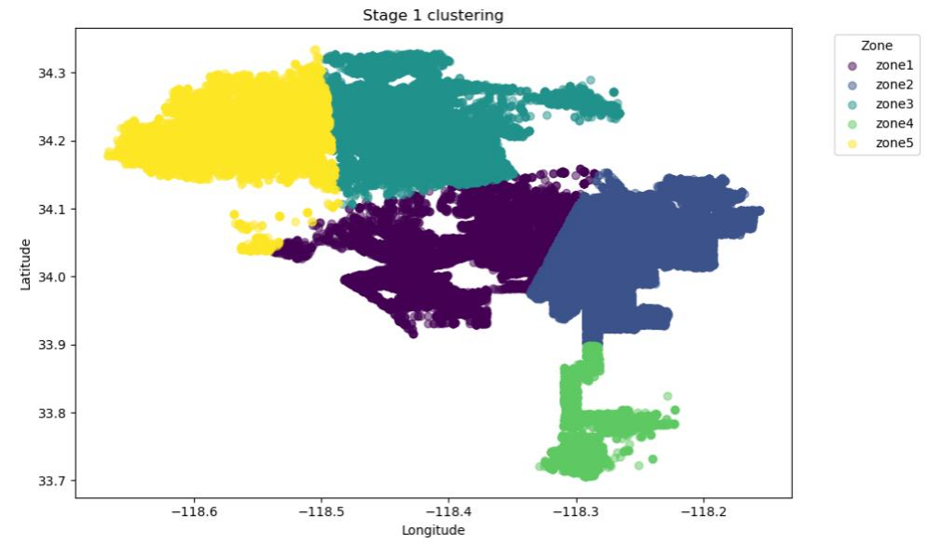
Stage 1 clustering
To handle the extensive crime data efficiently, I implemented a Breakdown Approach by dividing Los Angeles into five major geographic zones. This method simplifies the analysis and management of large datasets, ensuring a more focused examination of crime patterns.
Method:
KMeans Clustering: Utilized to group the dataset into five main regions based on latitude and longitude data.
This Breakdown Approach provided a foundation for a more detailed sub-zoning process in the next phase, enhancing the overall effectiveness of the crime hotspot analysis.

Slide 9
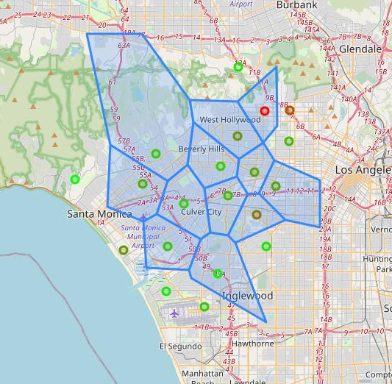
Stage 2 clustering
In the second phase, each of the five major zones was further subdivided into 20 smaller sub-regions to achieve higher granularity in the analysis. This detailed sub-zoning was accomplished using KMeans clustering, with the number of crimes serving as the primary factor for defining sub-regions.
The crime counts were normalized and standardized to ensure consistency and comparability across sub-regions. Gradient coloring was then applied to visually differentiate these sub-regions based on crime density.
Visualization:
To implement this, Folium was used to create interactive maps that overlay these sub-regions onto real-world maps of Los Angeles. This approach enabled a fine-grained analysis of high-risk areas, allowing law enforcement to focus their efforts on the most critical zones. The detailed sub-zoning process provided enhanced insights by highlighting crime hotspots within each major zone, offering a comprehensive and actionable perspective for crime prevention and resource allocation strategies.

Slide 10
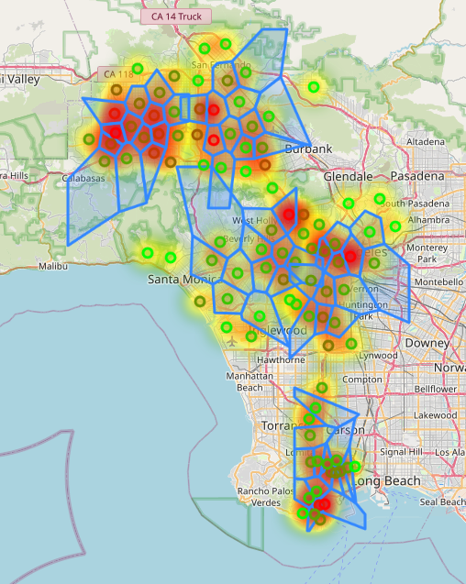
Spatial analysis
In the final spatial analysis, I combined all the sub-region maps and included a heatmap to illustrate the severity of crimes across Los Angeles. This comprehensive visualization, using gradient coloring for differentiation, highlights the exact regions where crime rates are high and low. Notable high-crime zones identified include Los Angeles Downtown, Hollywood, San Pedro, and Panorama City.
The heatmap further supports the need for targeted interventions in areas with higher severity of crimes, enabling a more effective and efficient approach to crime prevention and public safety enhancement.
This project enhances public safety by analyzing crime data to identify hotspots, allowing for effective resource allocation, preventive measures, and informed urban planning, ultimately improving community safety.

Slide 11
Skills overview
This project highlights my proficiency in Python, data analytics, and data visualization, demonstrating my ability to transform raw data into actionable insights.
Using Python, I leveraged powerful libraries such as Pandas for data manipulation, Scikit-Learn for machine learning and clustering algorithms, and Folium for creating interactive maps. I employed comprehensive data preprocessing methodologies including standardization and normalization to ensure data consistency and comparability.
By utilizing gradient scaling, I effectively visualized the density and severity of crimes. My analytical skills allowed me to categorize and bucket crime types, weapon types, and premise types, assigning severity scores to each record. This meticulous approach enabled me to create a detailed heatmap and spatial analysis, pinpointing high-risk areas like Los Angeles Downtown and Hollywood. The result is a robust tool that supports strategic decisions in resource allocation, urban planning, and public safety.
This project exemplifies my ability to articulate and shape real-world data into a tangible, impactful product, showcasing my efficiency in Python and data analytics.

